Slide 1
Ethereum Tutorial
Source of most materials:
Xiwei Xu, Ingo Weber, and Mark Staples. Architecture for Blockchain Applications. Springer, 2019

Slide 2
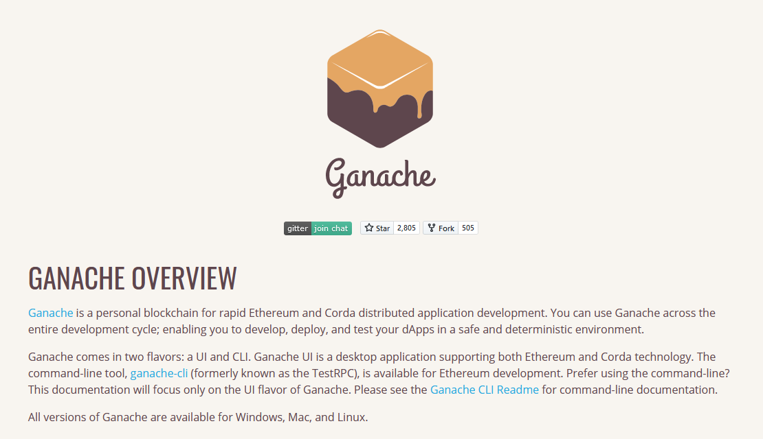
Goals
Assignment 2: smart contract development
Setting up a development environment based on Ganache

Slide 3
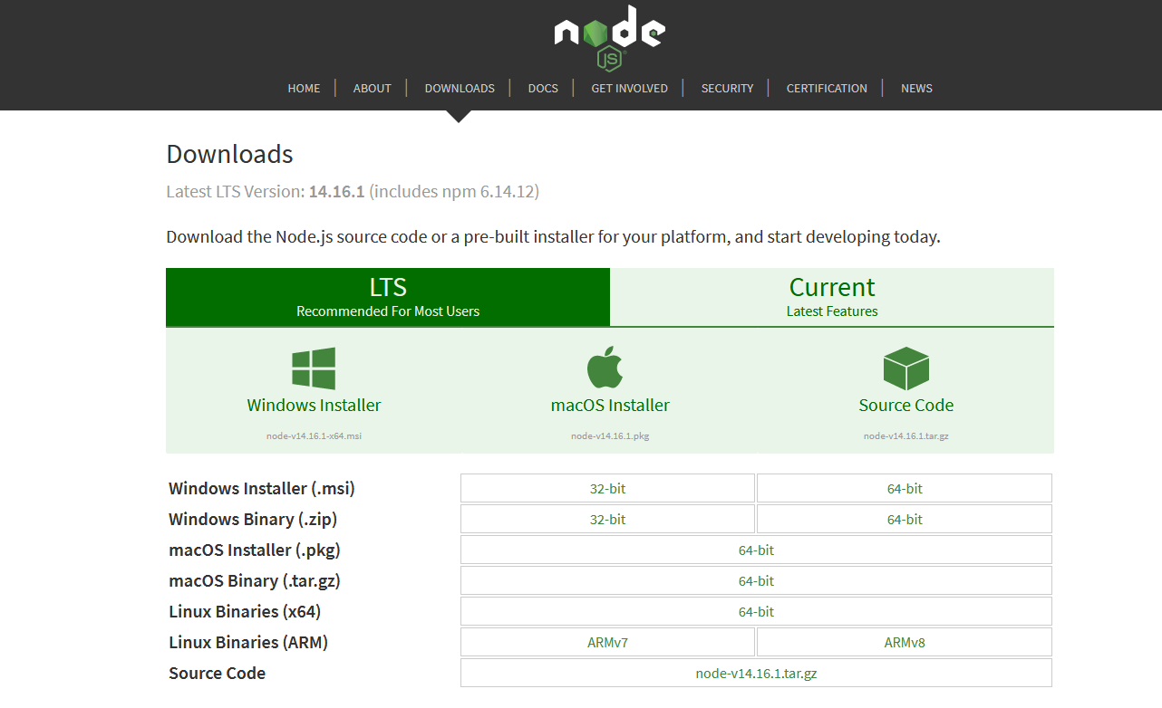
Download and Install Node.js
In Linux
Install/Verify you have curl and git
If not, run sudo apt-get install curl or sudo apt-get install git respectively
Install/Verify you are running at Node JS LTS (v14)
To check: Run node -v at your command line
If not correct, download/update Node JS from:
https://nodejs.org/en/download/
Or run:
curl -sL https://deb.nodesource.com/setup_12.x | sudo -E bash -
sudo apt-get install -y nodejs
Confirm that you have npm installed (it comes automatically when you download Node.js)
To check: Run npm -v at your command line
To update: npm install npm@latest -g
Need of npm for the following installations:
npm (originally short for Node Package Manager) is a package manager for the JavaScript programming language.
npm, Inc. is a subsidiary of GitHub (a subsidiary of Microsoft), that provides hosting for software development and version control with the usage of Git.

Slide 4
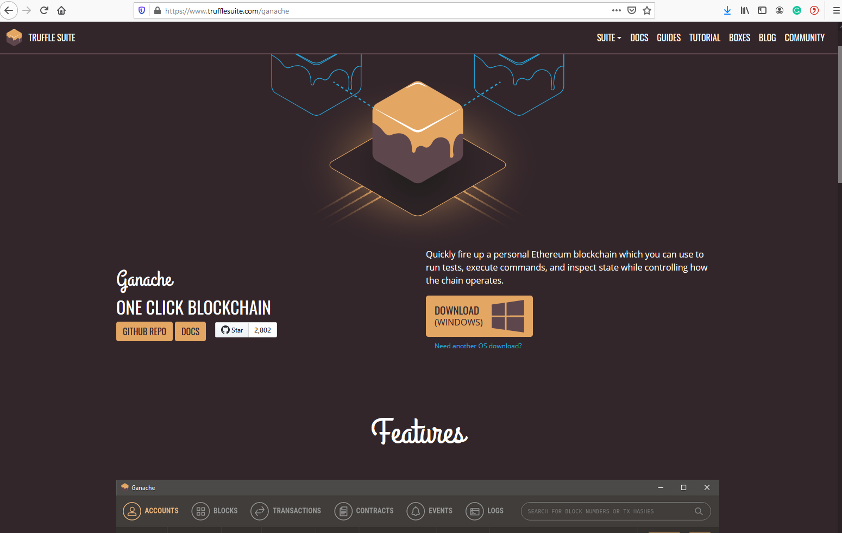
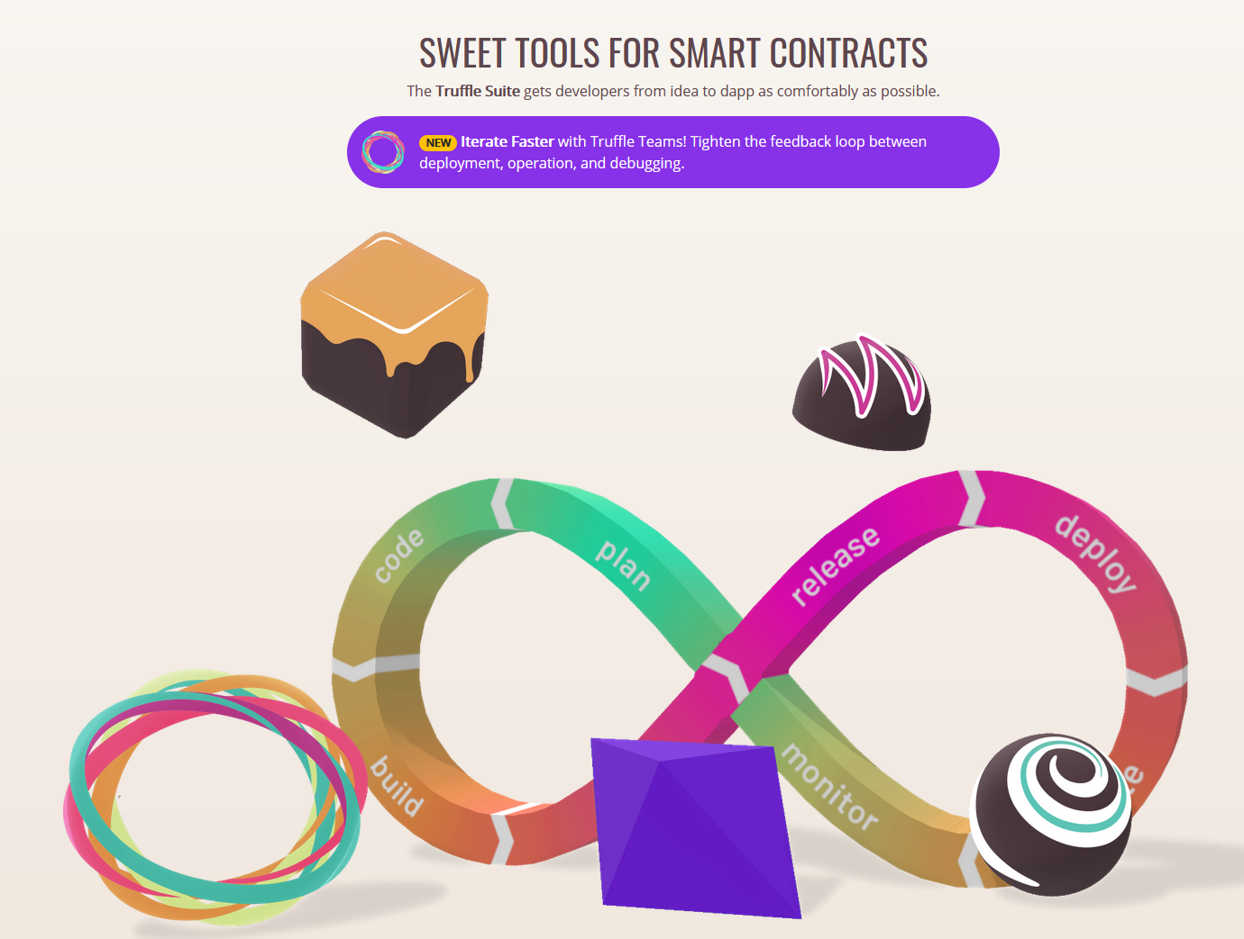
Install Ganache CLI
Simulates a stateful blockchain system on your own machine
Create a new folder for working on the next assignment,
e.g., by typing mkdir 2021-SABA-A2
Make sure to run all the following npm commands in this folder
Install Ganache CLI (part of the Truffle suite of Ethereum development tools)
Options a) Run npm install -g ganache-cli at your command line (command line only)
Option b): Download from here (comes with UI) https://www.trufflesuite.com/docs/ganache/quickstart
Documentation: https://github.com/trufflesuite/ganache-cli
Notes:
and make sure your Nodejs files (Step 7) are located in this folder when you execute them

Slide 5
Run Ganache
Run once, e.g. by entering ganache-cli , then copy the 12-word mnemonic
Enter the mnemonic in the UI when you create your workspace, or
If you use the command line, always start ganache with ganache-cli -m "<your mnemonic here>”
Also make sure your IP address (typically localhost / 127.0.0.1) and port are always the same
Note one difference: Ganache UI workspaces store the state persistently; Ganache-CLI by default starts with a ‘fresh’ blockchain system, i.e., with 10 accounts having 100 Ether each. Write your programs accordingly (assuming the state is or isn’t persisted).

Slide 6
Install HD Wallet-enabled Web3 provider
Sign transactions for addresses derived from a 12-word mnemonic
Run npm install -g truffle
Run npm install @truffle/hdwallet-provider
Documentation: https://github.com/trufflesuite/truffle
If not already installed, install the Web3js library:
Run npm install web3

Slide 7
Create a JS file that uses HD Wallet
Make sure Ganache is running
Run with nodejs <yourfile> (or node <yourfile> )
Files used in this tutorial will be made available on ISIS
note that they do not necessarily follow best coding practices

Slide 8
A first interaction with Ganache
var HDWalletProvider = require("@truffle/hdwallet-provider");
// load single private key as stringvar
provider = new HDWalletProvider("hope cabin bone sunset thrive eight tray rubber earth resemble survey nasty", "http://localhost:8545");
var addresses = provider.addresses;
// do something
var Web3 = require('web3‘);
var web3 = new Web3(provider);
console.log("Hashrate:");
web3.eth.getHashrate().then(console.log);
console.log("Block Number:");
web3.eth.getBlockNumber().then(console.log);
console.log("Balance of account 0: " + addresses[0]);
web3.eth.getBalance(addresses[0]).then(console.log);
console.log("Balance of account 1: " + addresses[1]);
web3.eth.getBalance(addresses[1]).then(console.log);
// stop HDWallet provider
provider.engine.stop();

Slide 9
Transform Wei into Ether
var HDWalletProvider = require("@truffle/hdwallet-provider");
// load single private key as string
var provider = new HDWalletProvider("hope cabin bone sunset thrive eight tray rubber earth resemble survey nasty", "http://localhost:8545");
var addresses = provider.addresses;
// do something
var Web3 = require('web3‘);
var web3 = new Web3(provider);
web3.eth.getHashrate().then(r => console.log("Hashrate: ", r)).catch(err => console.log("An error occurred ", err));
web3.eth.getBlockNumber().then(r => console.log("Block Number: ", r)).catch(err => console.log("An error occurred ", err));
web3.eth.getBalance(addresses[0]).then(r => console.log("Balance (in Ether) of account 0", addresses[0], "is :", weiToEther(r))).catch(err => console.log("An error occurred ", err));
web3.eth.getBalance(addresses[1]).then(r => console.log("Balance (in Ether) of account 1", addresses[1], "is :", weiToEther(r))).catch(err => console.log("An error occurred", err));
printAccountBalance(addresses[2]);
// stop HDWallet provider
provider.engine.stop();
// functions
function printAccountBalance(address){
web3.eth.getBalance(address) .then(r => console.log("Balance (in Ether) of account", address, "is :", weiToEther(r))) .catch(err => console.log("An error occurred", err));
}
function weiToEther(wei){
return web3.utils.fromWei(wei, 'ether‘);
}

Slide 10
Transfer of Ether
var HDWalletProvider = require("@truffle/hdwallet-provider");
// load single private key as string
var provider = new HDWalletProvider("hope cabin bone sunset thrive eight tray rubber earth resemble survey nasty", "http://localhost:8545");
var addresses = provider.addresses;
// do something
var Web3 = require('web3‘);
var web3 = new Web3(provider);
web3.eth.getBlockNumber().then(r => console.log("Block Number: ", r)).catch(err => console.log("An error occurred ", err));
printAccountBalance(addresses[0]);
printAccountBalance(addresses[1]);
printAccountBalance(addresses[2]);
const weiValue = Web3.utils.toWei('99', 'ether‘);
sendTx().catch(err => console.log("An error occurred", err));
// stop HDWallet provider
provider.engine.stop();
// functions
async function sendTx(){
const promise = await web3.eth.sendTransaction({ from: addresses[0], to: addresses[1], value: weiValue });
console.log("Transaction sent", promise.r) printAccountBalance(addresses[0]); printAccountBalance(addresses[1]); printAccountBalance(addresses[2]);
}
function printAccountBalance(address){
web3.eth.getBalance(address) .then(r => console.log("Balance (in Ether) of account", address, "is :", weiToEther(r))) .catch(err => console.log("An error occurred", err));
}
function weiToEther(wei){
return web3.utils.fromWei(wei, 'ether‘);
}

Slide 11
Install Solidity Compiler
Run npm install solc -g from your command line
Documentation: https://solidity.readthedocs.io/en/v0.5.13/installing-solidity.html
Create, deploy, and invoke a smart contract ☺

Slide 12
Ethereum Tutorial
Source of most materials:
Xiwei Xu, Ingo Weber, and Mark Staples. Architecture for Blockchain Applications. Springer, 2019

